Slide 1
WELCOME

Slide 2
WEBSITE ABOUT INDIA
PARTICIPANTS:
  SECOND YEAR IT STUDENTS
  HIMA HARDEEP (19L31A1268)
  MADAN(19L31A1275)
  AMRUTHI(19L31A1252)
  NITHIN(19L31A1241)
  SIDDU(19L31A1281)

Slide 3
WHAT MOTIVTED US TO CHOOSE THIS PROJECT
AS AN INDIAN,WE SHOULD AWARE OF OUR TRADITIONS,TOURISM SPOTS,CULTURE,FAMOUS DISHES..ETC
THIS THINGS MADE US TO CHOOSE THIS PROJECT

Slide 4
IMPLEMENTATION OF THIS PROJECT
BY USING THE HTML WE ARE GOING TO CREATE THE BLOG
WE USE THE HOSTING BY USING THE GOOGLE DRIVE
WE USE THE GOOGLE FOR REFERENC TO KNOW ABOUT THE THING

Slide 5
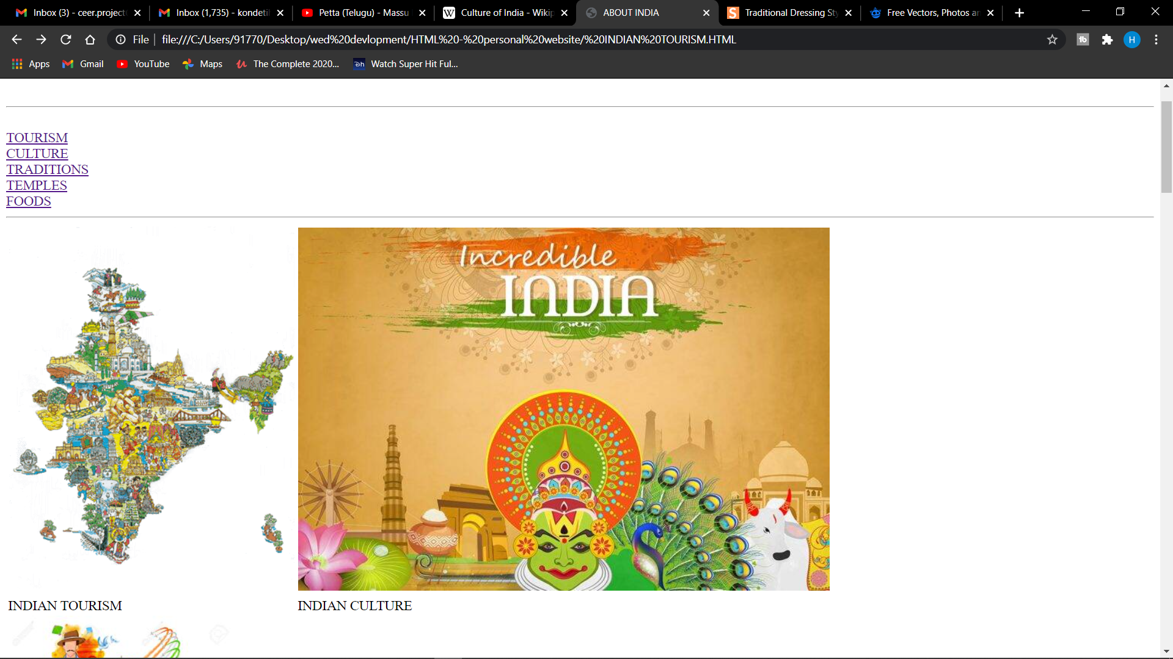
HOME PAGE OF THE WEBSITE ABOUT INDIA

Slide 6
THANK YOU

